Slide 1
Decision Dashboard for Urban Food Production
Weekly Progress Update
Chiranjeevi Venkata Shiva Ruthvik Savaram, Y247K345, 10/7/2026
Wichita State University — MS in Data Science
Notes:
Good [morning/afternoon]. This is my weekly progress update on the Urban Food Production Decision Dashboard. This week I collected Census ACS data for the 516 KC metro tracts, merged it with the health data, and did first exploratory analysis.

Slide 2
Tasks
Previous Week
This Week
Applied the Kansas City metro filter (14 counties, per OMB Bulletin No. 23-01) to the dataset — Completed
Confirmed the health variable shortlist against the reference document: Obesity, Diabetes, High Blood Pressure — Completed
Identified Demographic & Socioeconomic data (Census ACS) as the next category to pursue — Completed
Found the Census ACS data for demographic and socioeconomic variables (13 candidate variables) — Completed
Collected the ACS variables for all 516 KC metro tracts (2019 5-year estimates) — Completed
Added the ACS data to the health dataset; one-to-one merge validated (516 of 516 matched) — Completed
Cleaned the data and ran initial exploratory and correlation analysis — Completed
Confirm the final variable set from the candidates — In Progress
Decision Dashboard for Urban Food Production — Weekly Progress
2
Notes:
Last week I filtered the data to the KC metro and confirmed the three health variables. The commitment for this week was to find, collect, and add the ACS variables to the health dataset. Those three are done. I also cleaned the data and did first exploratory and correlation analysis. What's still in progress is confirming the final variable set — what I have now is a candidate set.

Slide 3
Study Area and Health Indicators
14
CDC PLACES 2023 release — crude prevalence, adults (% of adults)
Indicator | What it measures | Mean | Min | Max | Missing
OBESITY_CrudePrev | Adult obesity | 37.9 | 25.5 | 57.1 | 0
DIABETES_CrudePrev | Adult diabetes | 11.1 | 3.7 | 32.3 | 0
BPHIGH_CrudePrev | Adult high blood pressure | 33.6 | 17.5 | 59.8 | 0
counties (9 MO, 5 KS)
516
How to read these: preliminary indicators of community health need across tracts. They are not direct measures of food insecurity. Means are simple averages of tract values (not population-weighted).
census tracts
No map yet — tract boundary files have not been obtained (planned next).
Decision Dashboard for Urban Food Production — Weekly Progress
3
Notes:
Quick reminder of the study area: 14 counties, 516 census tracts. Health data come from CDC PLACES, three indicators, all fully populated for the 516 tracts. I want to be careful about what these mean: they are preliminary indicators of community health need, not direct measures of food insecurity. The averages shown are simple tract averages, not population-weighted. I don't have a map yet because I haven't obtained the tract boundary files; that's in next week's plan.

Slide 4
ACS Data: Candidate Variables and Geography Match
American Community Survey 5-year estimates at the census tract level
13 candidate variables (not yet final)
Matching ACS to the PLACES tracts
Group | Variables
Economic need | Poverty %; SNAP households %; Median household income; Median gross rent; Median home value
Transport & housing | No-vehicle households %; Renter-occupied %; Households with children %
Population | Age 65+ %; Foreign-born %; Hispanic/Latino %; Non-Hispanic Black %
Education | Bachelor's degree or higher %
430 / 516
516 / 516
tracts matched
ACS 2023 5-year
tracts matched
ACS 2019 5-year
Likely cause of the mismatch: census tract boundary vintage — the newer ACS release uses different tract IDs than the PLACES file.
Decision: use 2019 ACS (2015–2019) for the working dataset, since it matches every PLACES tract.
Limitation to document: ACS and PLACES do not cover exactly the same reference period.
Decision Dashboard for Urban Food Production — Weekly Progress
4
Notes:
This slide covers the ACS side. I identified 13 candidate variables across economic need, transportation and housing, population, and education. This is a candidate set — I haven't confirmed the final selection. The important finding was a geography issue: with the 2023 ACS five-year data only 430 of my 516 tract IDs matched. The likely cause is tract boundary vintage, because tracts were redrawn after the 2020 Census. The 2019 five-year data matched all 516, so I used it for the working dataset. The trade-off is that ACS 2015–2019 and the PLACES release don't cover exactly the same period, and I'll document that as a limitation.

Slide 5
Data Cleaning and Integration
From two sources to one validated 516-tract dataset
CDC PLACES health data
Clean and standardize
Merge and validate
Combined dataset
516 tracts, 3 indicators
+
ACS 2019 candidate data
13 variables
Negative sentinel values (income, rent, home value) set to missing; tract ID standardized
One-to-one merge on census tract ID
516 tracts
kc_metro_combined_
health_socioeconomic.csv
Merge validation
Missing values were investigated, not assumed to be zero:
516
516
516
0
1 tract has zero denominators — its percentage variables and median income stay missing
Median gross rent: 17 tracts missing; median home value: 4 tracts missing
No imputation or removal yet — handling decided once the final variables are chosen
records
unique tracts
matched
unmatched
Decision Dashboard for Urban Food Production — Weekly Progress
5
Notes:
This is the integration workflow. I combined the PLACES health data with the 2019 ACS candidate data, cleaned them, and merged on census tract ID. Cleaning meant converting the Census negative sentinel values in median income, rent, and home value to missing rather than treating them as real numbers, and standardizing the tract ID. Validation: 516 records, 516 unique tracts, 516 matches, zero unmatched — a clean one-to-one merge. On missing values: one tract has zero denominators so its percentages stay missing; median rent is missing for 17 tracts and home value for 4. I haven't imputed or dropped anything yet, because that depends on which variables end up in the final model.

Slide 6
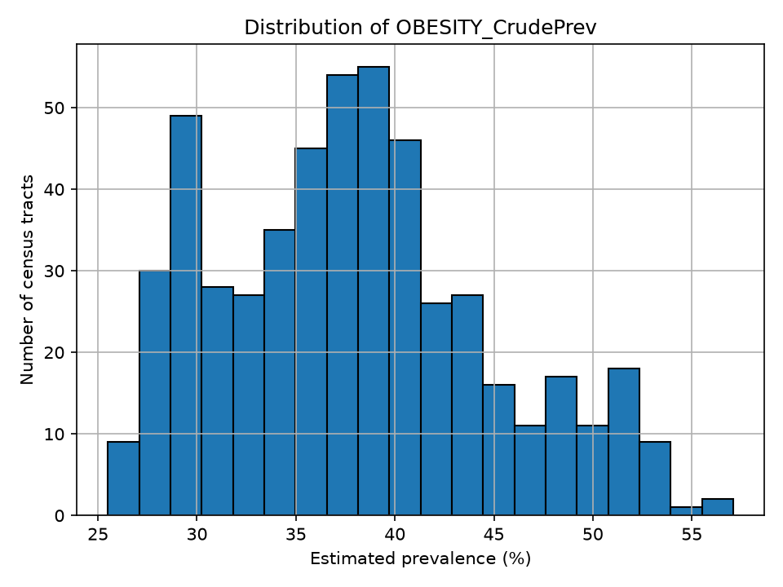
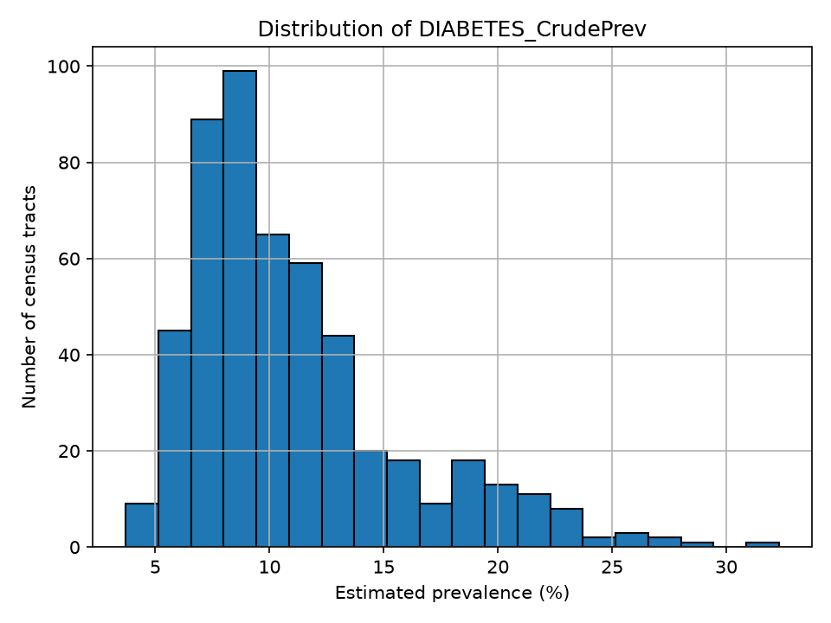
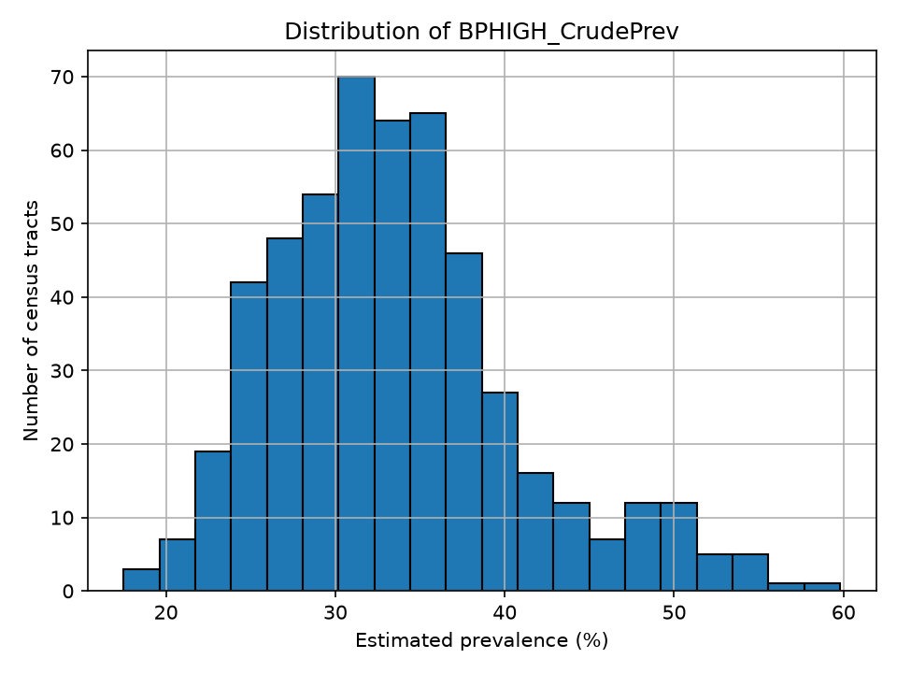
Exploratory Analysis — Health Indicators
Obesity: mean 37.9% (range 25.5–57.1). Most tracts fall between the mid-30s and about 40%.
Diabetes: mean 11.1% (range 3.7–32.3). Right-skewed — most tracts below about 15%, a few much higher.
High blood pressure: mean 33.6% (range 17.5–59.8). Concentrated around 30–37%, with a modest tail to higher values.
Distributions across the 516 census tracts (unweighted). Descriptive only — not population-weighted metro averages and not yet mapped.
Decision Dashboard for Urban Food Production — Weekly Progress
6
Notes:
These histograms show how each health indicator is distributed across the 516 tracts. Obesity is mostly in the mid-30s to about 40 percent. Diabetes is lower overall and right-skewed — most tracts are under about 15 percent and a few are much higher. High blood pressure clusters around 30 to 37 percent with a modest tail. These are descriptive views across tracts, not population-weighted averages, and I haven't mapped them yet.

Slide 7
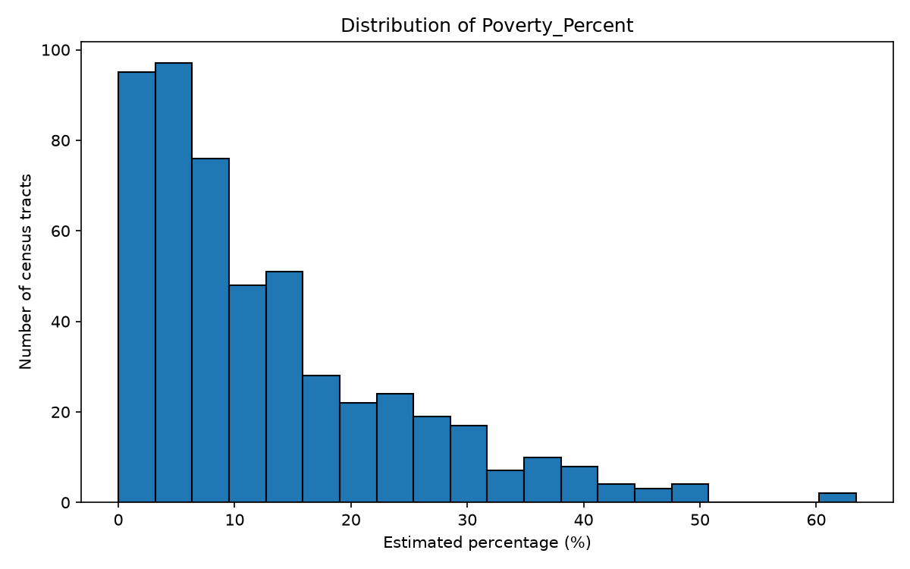
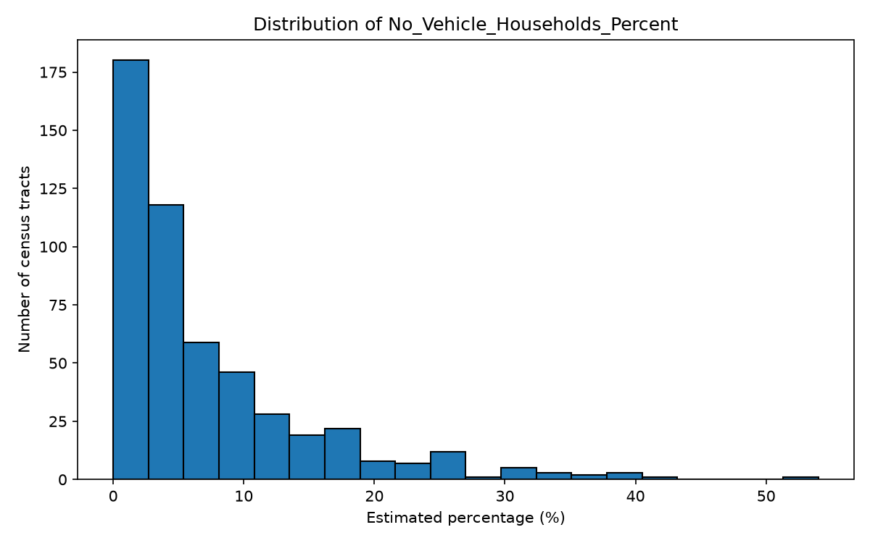
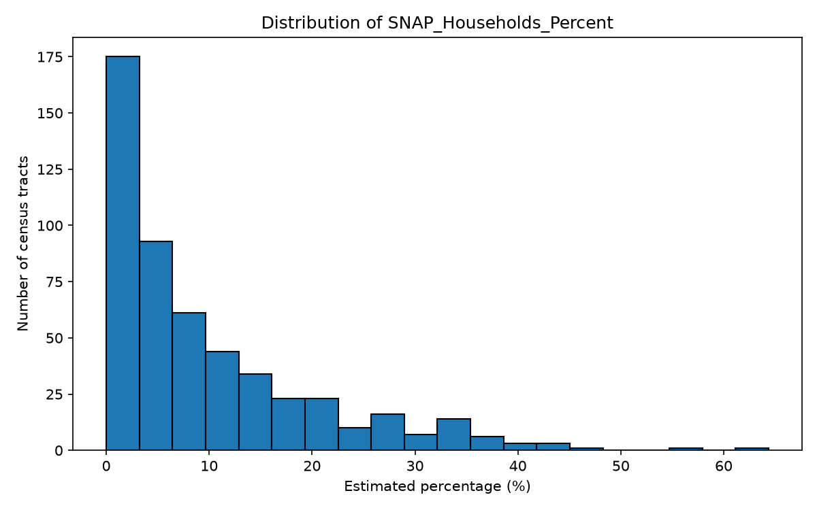
Exploratory Analysis — Socioeconomic Indicators
Poverty: mean 12.7% (range 0–63.4). Right-skewed — many low-poverty tracts, a small number above 40%.
Households without a vehicle: mean 7.2% (range 0–54.0). Most tracts are under 10%; a small number exceed 30%.
SNAP households: mean 9.6% (range 0–64.4). Same right-skewed shape, with many tracts near the low end.
515 of 516 tracts have values (1 tract missing due to zero denominators). Descriptive across tracts, not population-weighted.
Decision Dashboard for Urban Food Production — Weekly Progress
7
Notes:
The three socioeconomic indicators share a similar shape: right-skewed. Many tracts have low percentages and a smaller number have much higher values — up to roughly 63 percent for poverty and 64 percent for SNAP. Means are 12.7 percent for poverty, 7.2 percent for no-vehicle households, and 9.6 percent for SNAP. One tract has no value because of zero denominators. Again, descriptive across tracts, not geographic patterns yet.

Slide 8
Correlation Analysis — Overlapping Candidate Variables
The 8 strongest pairs (of 78) among the 13 candidate ACS variables
What this tells us
Several candidates overlap (poverty and SNAP; income, home value, and education) — using all of them could double-count the same pattern.
A strong correlation does not automatically mean a variable is dropped; each choice will be reviewed.
Poverty, no-vehicle households, SNAP, and the three health indicators are key candidates for further review.
Final criteria and weights are not yet decided.
Decision Dashboard for Urban Food Production — Weekly Progress
8
Notes:
I computed correlations among the 13 candidate ACS variables to see which ones overlap. The strongest are median income with home value at 0.88, poverty with SNAP at 0.86, bachelor's degree with home value at 0.85, and foreign-born with Hispanic or Latino at 0.81. Poverty and no-vehicle households are at 0.75. The point is variable selection: if two measures move together, using both could double-count the same pattern in a weighted model. But high correlation doesn't automatically mean I drop one — I'll review each. Poverty, no-vehicle households, SNAP, and the three health indicators are the key candidates I want to look at next. Final criteria and weights are not decided. The population-group variables are context variables; I'm not treating demographic identity as inherently indicating disadvantage.

Slide 9
Next Week Plans (10/14/2026)
Activities/Tasks
Finalize the demographic and socioeconomic variable set from the 13 candidates (review correlated pairs)
Obtain census tract boundary (polygon) data and create a preliminary map of the 516 tracts
Identify suitable food-access datasets and measures
Look for parcel, vacant-land, zoning, or land-use information (ORKA / KCMO)
Expected Outcomes
A confirmed list of demographic and socioeconomic variables
A first tract-level map of the study area
A shortlist of candidate food-access and parcel/land-use data sources
Deliverable
Final variable list, preliminary tract map, data-source shortlist, and progress presentation
Decision Dashboard for Urban Food Production — Weekly Progress
9
Notes:
Next week: finalize the variable set, get tract boundary files and make a first map, and start identifying food-access and parcel or land-use data. Still ahead after that: AHP weighting, MCDA suitability scoring, and the dashboard. None of those have been started and I'm not presenting them as done.

Slide 10
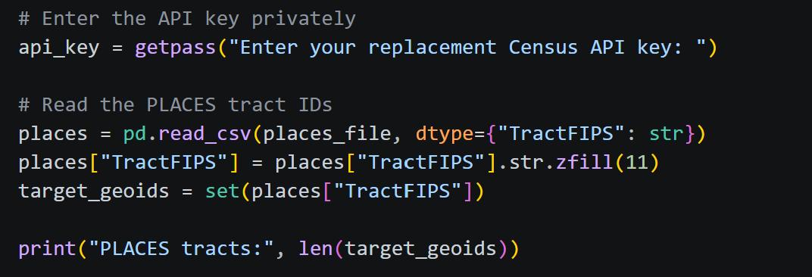
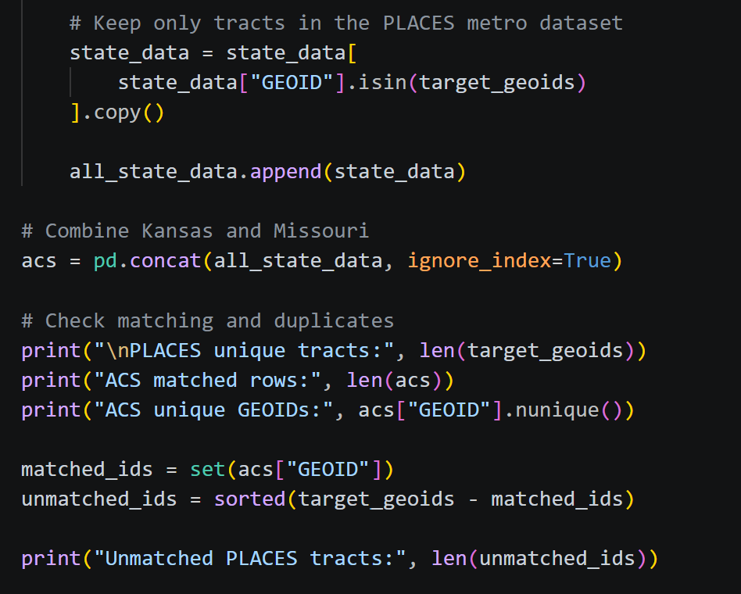
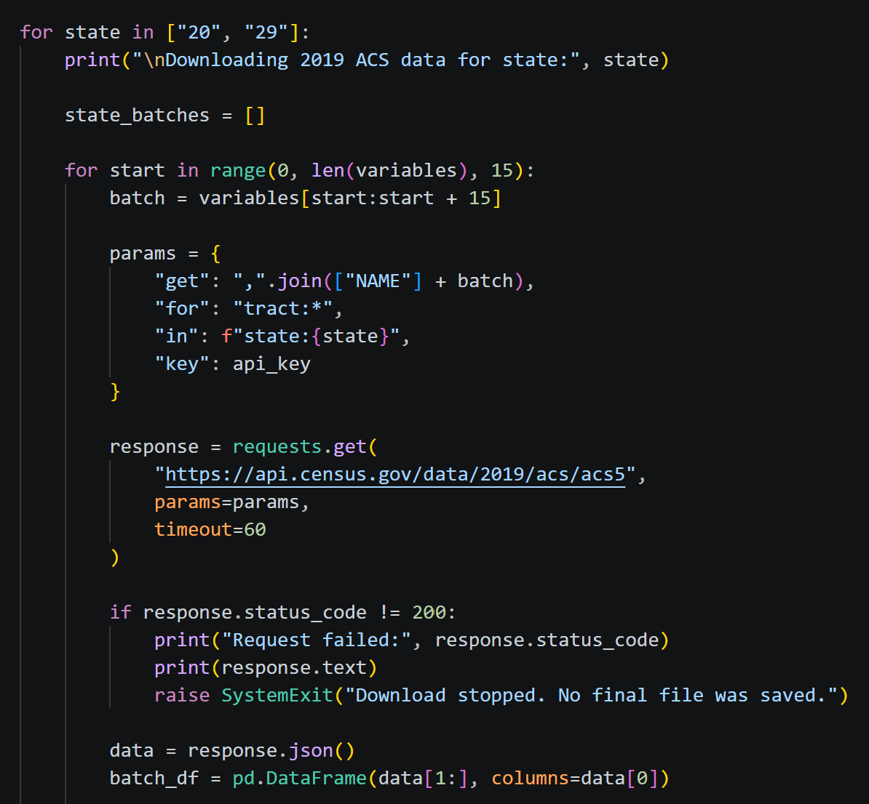
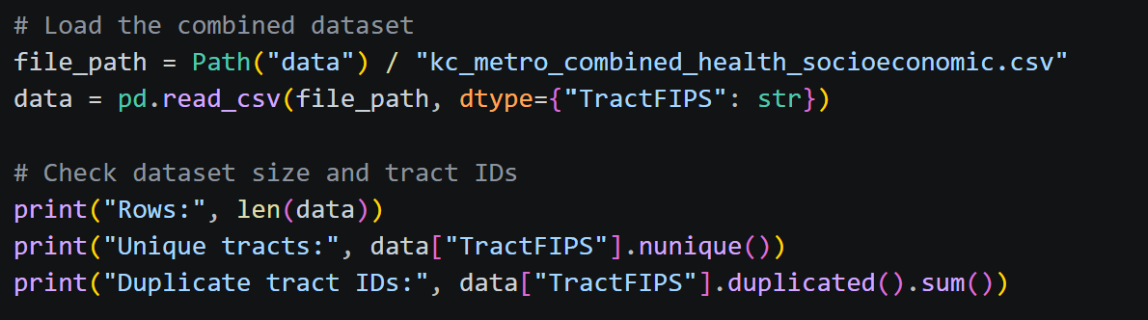
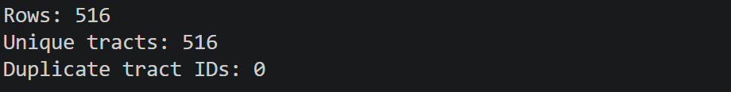
Appendix — Code
10
Notes:
Only go here if asked how I got the numbers. Walk through: pull ACS tract data for the 14 counties, convert sentinel values to missing, compute percentages from counts and denominators, standardize the tract ID, then merge one-to-one with the health file and validate.

